Slide 1
Business Analytics (IM561)
15 min Prerequisites
for Intelligent Video Analytics
with Deep Learning
Jongho Kim
December & Company Inc.
Spring, 2019

Slide 2
Prerequisites for Intelligent Video Analytics
Welcome to “Intelligent Video Analytics with Deep Learning”
This session is designed to 1. introduce frontier social science research and practices applying video analytics, 2. learn how to understand and analyze quantitative video data

Slide 3
Prerequisites for Intelligent Video Analytics
There is no prerequisite related with programming skills for this session.
Feel free to attend the session even if you do not have any technical background.

Slide 4
Prerequisites for Intelligent Video Analytics
Follow the steps below for 15 minutes.
Step1. Quick Tutorial for Google Colaboratory (5 min)
Step2. Take Any Video ( < 60 seconds ) (2 min)
Step3. Upload your Video on Google Colaboratory (3 min)
Step4. Create an Account at Google Cloud Platform (5 min)
If you get stuck, please email me at the following address:
Email: quantic.jh@gmail.com

Slide 5
Step1. Quick Tutorial for Google Colab

Slide 6
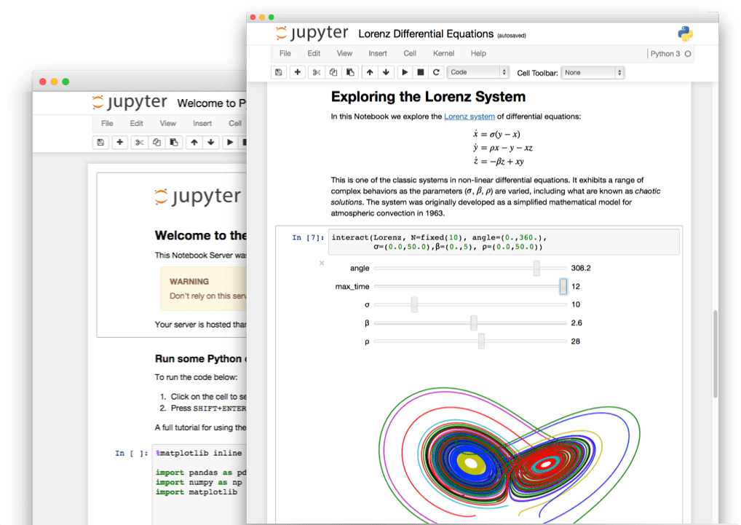
What is Google Colaboratory?
Google Colab is a free cloud service based on Jupyter Notebooks that support totally free GPU
What is the Jupyter Notebook?
An open-source web application that allows you to create documents that contain live code, equations, visualizations and narrative text.

Slide 7
Hello World! on Google Colab
Access to URL: https://colab.research.google.com/notebooks/welcome.ipynb
We only need a Google account to do this
Click Here!
Click Here!

Slide 8
Hello World! on Google Colab
Write “print(“Hello World”)” as above
Click button or type “CTRL + ENTER”

Slide 9
Step2. Take Any Video (< 60 seconds)

Slide 10
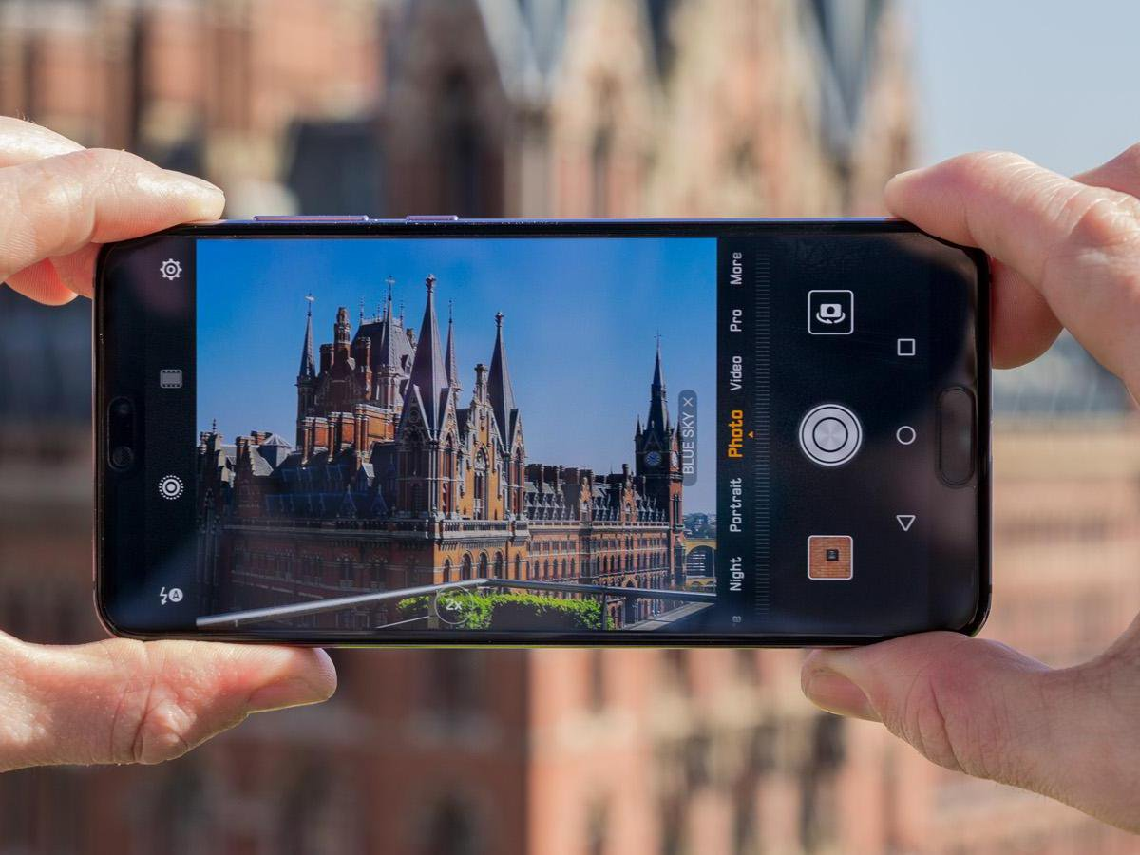
Take Any Video with Your Smartphone
We will detect and label entities, such as dogs, flowers, and people, throughout the entire video.

Slide 11
Step3. Upload your Video on Google Colab

Slide 12
File Upload on Colab
Step1. Access to URL: https://colab.research.google.com/notebooks/io.ipynb
Step2. Run the first cell “Local file system”
Click button or type “CTRL + ENTER”
Click Here!

Slide 13
Step4. Create an Account for Google Cloud API

Slide 14
Create an Account for Google Cloud API
Step1. Access to https://console.cloud.google.com/
Step2. Subscribe Google Cloud Platform
Note. Even if you register your credit card, you will not be charged.
Click Here!

Slide 15
Create an Account for Google Cloud API
Step3. Select or create a Google Cloud Platform project
Access below URL (manage resources page) and create a project
https://console.cloud.google.com/cloud-resource-manager
Click Here!

Slide 16
Create an Account for Google Cloud API
Step4. Enable the Cloud Video Intelligence API
Access below URL to enable Video Intelligence API
https://console.cloud.google.com/flows/enableapi?apiid=videointelligence.googleapis.com
Step5. Set up authentication, download JSON file that include your key
Go to the Create service account key page.
From the Service account list, select New service account.
In the Service account name field, enter a name.
Don't select a value from the Role list. No role is required to access this service.
Click Create. A note appears, warning that this service account has no role.
Click Create without role. A JSON file that contains your key downloads to your computer. (KEEP THIS JSON FILE!)
https://console.cloud.google.com/apis/credentials/serviceaccountkey

Slide 17
Thank you ☺
Contact Info: quantic.jh@gmail.com
감사합니다.

Slide 18
Appendix. Google Colaboratoy Useful Shortcuts
Actions | Colab | Jupyter
show keyboard shortcuts | Ctrl/Cmd M H | H
Insert code cell above | Ctrl/Cmd M A | A
Insert code cell below | Ctrl/Cmd M B | B
Delete cell/selection | Ctrl/Cmd M D | DD
Interrupt execution | Ctrl/Cmd M I | II
Convert to code cell | Ctrl/Cmd M Y | Y
Convert to text cell | Ctrl/Cmd M M | M
Split at cursor | Ctrl/Cmd M - | Ctrl Shift -

Slide 19
Appendix. Google Drive Access on Colab
First Step: Upload your data on Google Drive
http://drive.google.com
Second Step: Enter Authentication Code on Google Colab
Access: https://colab.research.google.com/notebooks/io.ipynb
Go to Url
Type Code

Slide 20
Appendix. Check Data Available on Google Drive
Type: !ls "/content/gdrive/My Drive/”
This is root directory for Google Drive
For a specific folder, !ls "/content/gdrive/My Drive/{Your Folder Name}”

